Slide 1
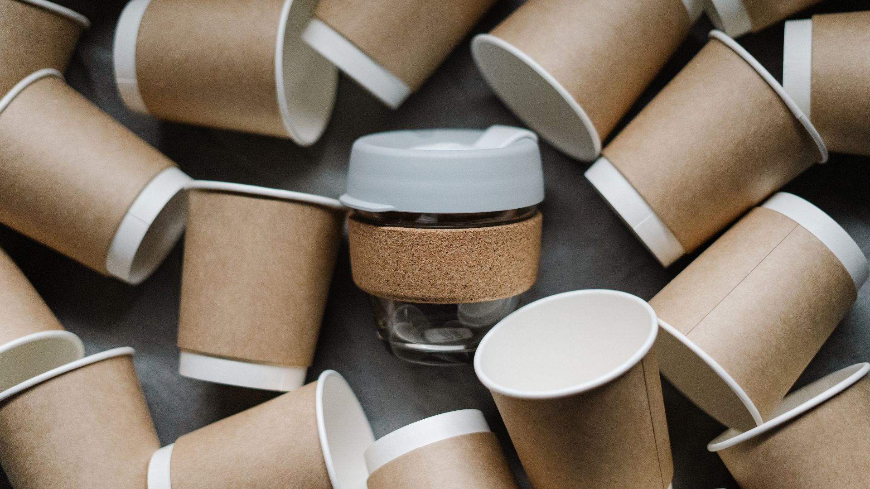
#Startupindia
presented by zomato
PACKATHON
Zomato Plastic-Free Orders

Slide 2
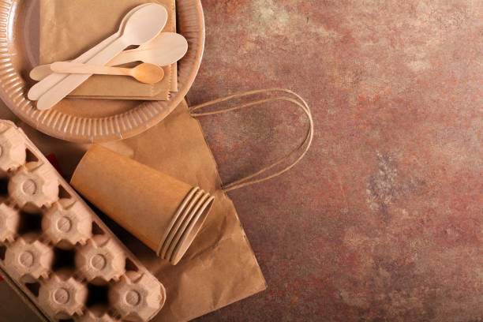

ABSTRACT
This abstract advocates for replacing plastic packaging with eco-friendly alternatives to combat environmental damage. We are here with some eco friendly proucts that are processed from Sugarcane Baggase,Corn starch,PLA &Dried coconut leaves which can reduce the usage of plastics in future

Slide 3
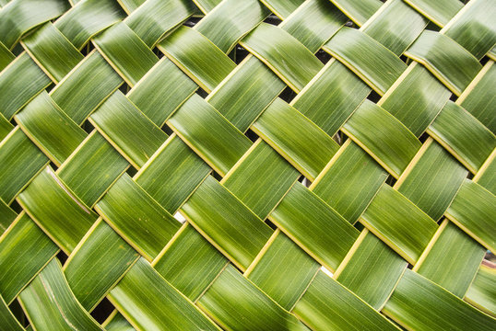
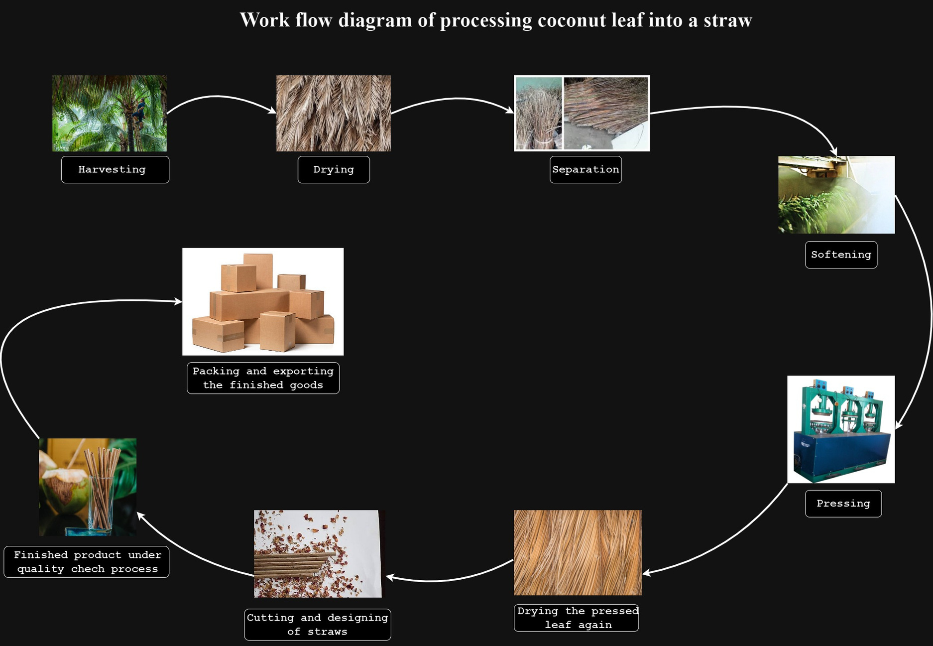

Slide 4


PROCESS OF MAKING COCONUT LEAF INTO STRAW
Harvesting 6. Drying (Again)
Drying 7.Cutting
Separation 8.Finishing
Softening 9.Quality Control
Pressing 10.Packaging
BENEFITS:
Biodegradability
Renewable Resource
Non-Toxic and Chemical-Free
Coconut leaf Cost
Raw Material=1rs
Transportation=1rs
Processing=0.50rs
Totall=2.50rs

Slide 5
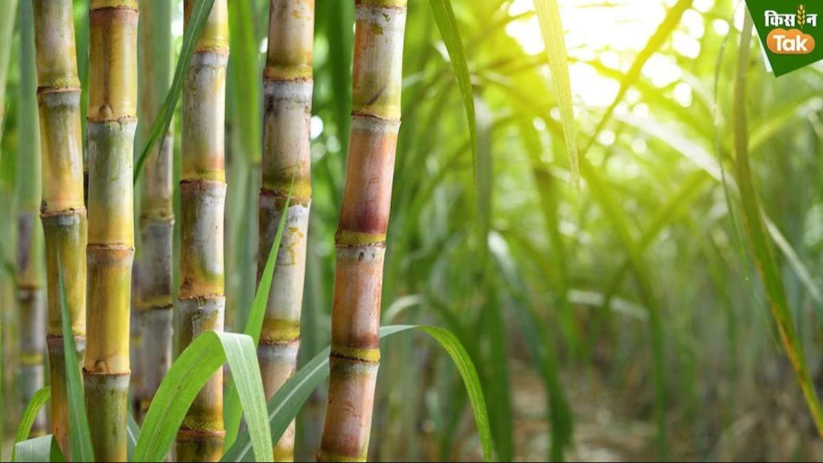
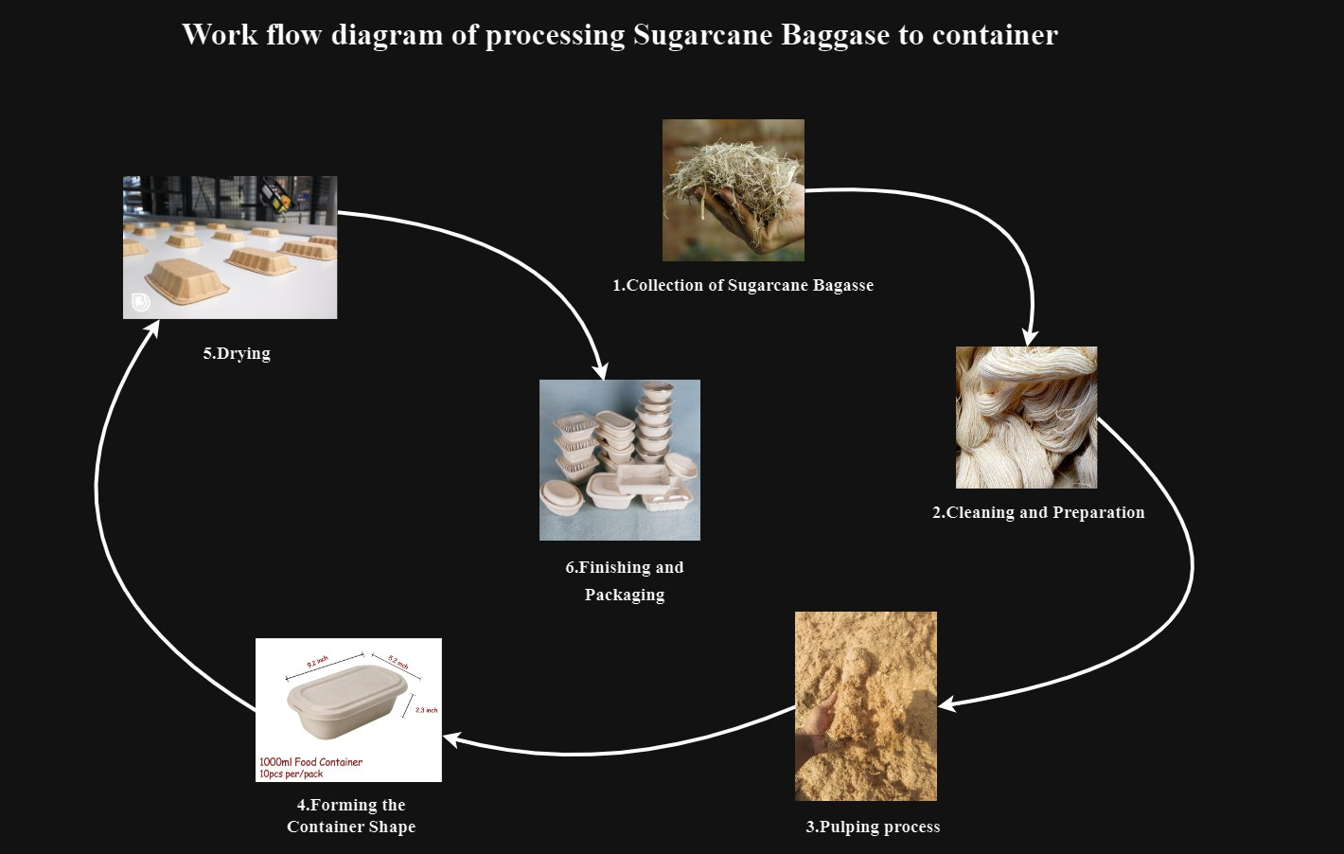

Slide 6
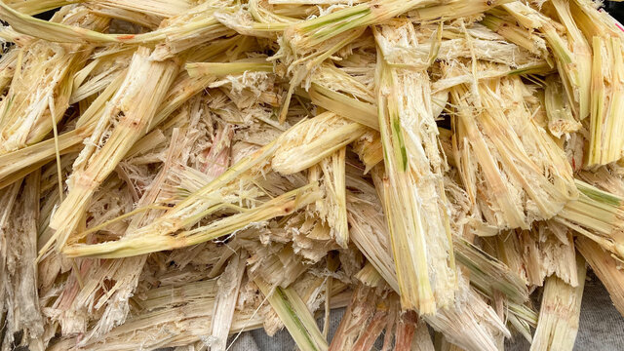
PROCESS TO MAKE SUGARCANE BAGGASE INTO A LEAK PROOF CONTAINER
1.Collection of Sugarcane Bagasse
2. Cleaning and Preparation
3. Pulping
4. Forming the Container Shape
5. Drying
6. Finishing and packaging
7. leak proof coating
BENEFITS:
Renewable and Biodegradable
Cost-Effective Eco-Friendly Solution
Versatile and Durable

Slide 7
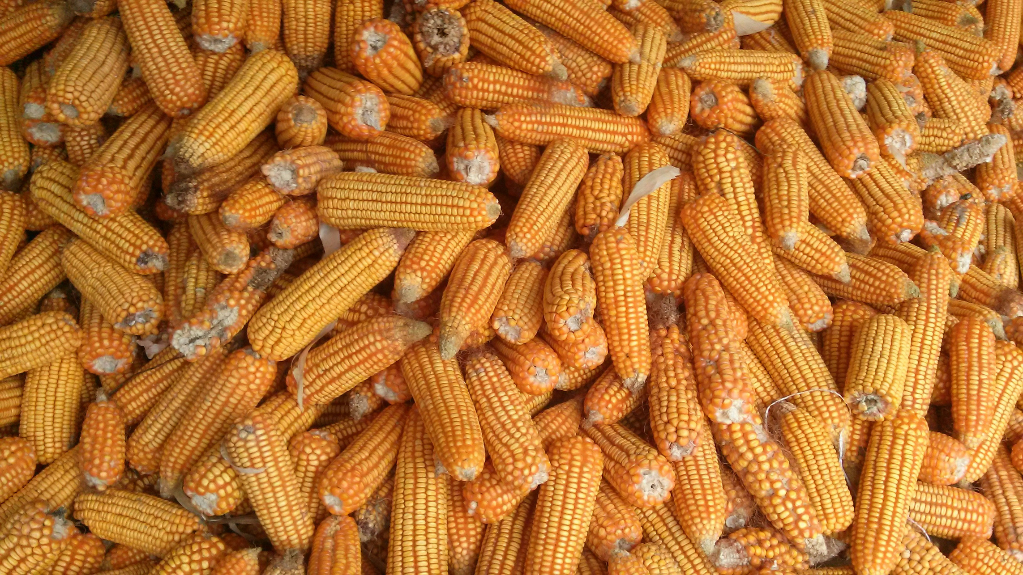
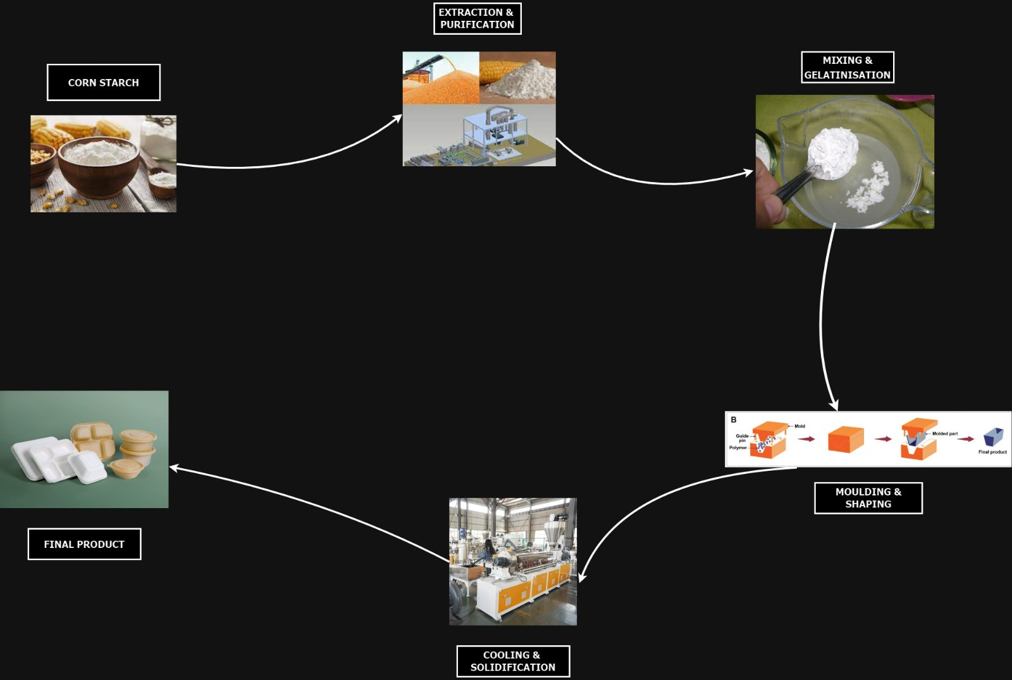

Slide 8
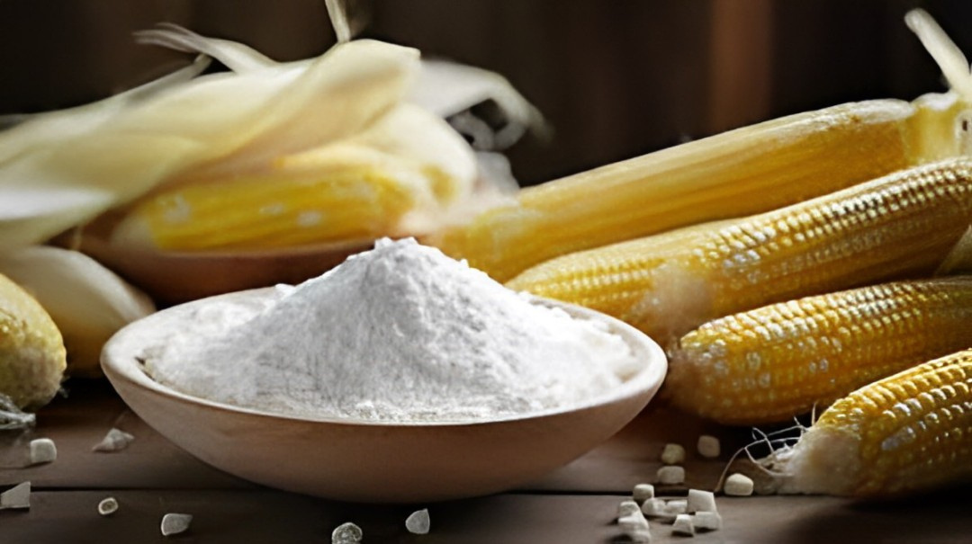
PROCESS TO CONVERT CORN STARCH INTO CONTAINER LIDS
1. Extraction and Purification
2. Mixing and Gelatinization
3. Molding and Shaping
4.Cooling and Solidification
5.Drying
6.Finishing and Packaging
BENIFITS:
Resistant to oils.
Resistant to fats.
Cost competitive.
Extremely durable.
Have a low flammability.
High aroma barrier.
Excellent for print applications.
Resistant to UV.

Slide 9
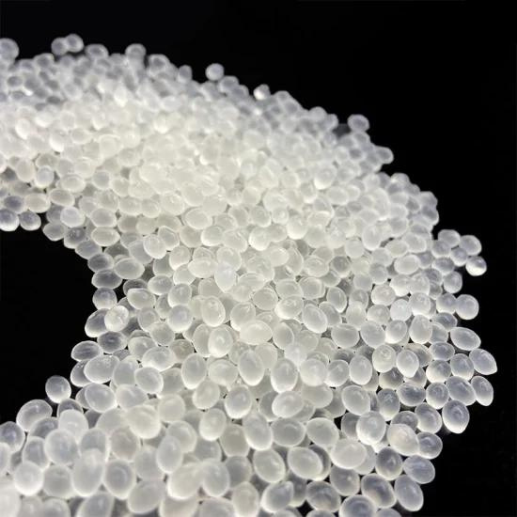
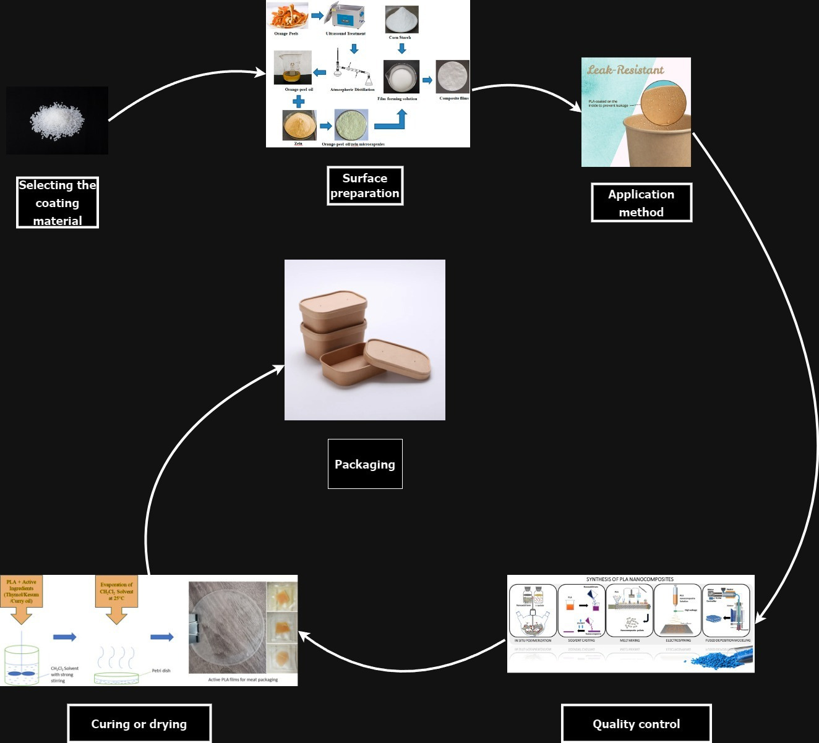

Slide 10
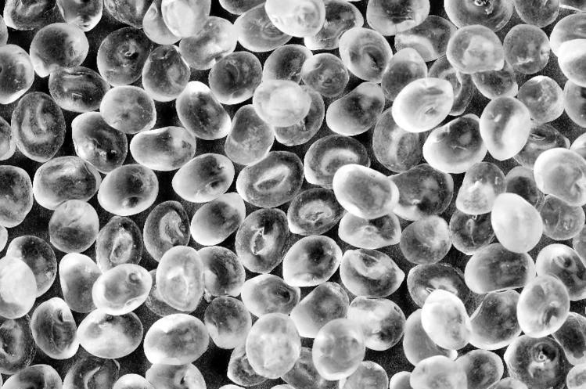
PROCESS TO APPLY PLA AS A LEAK PROOF LAYER FOR A DESIGNED CONTAINER
1.Designing the Container 5. Quality Control
2.Material Selection 6. Surface Treatment (Optional)
3.Injection Molding 7. Packaging
4. Cooling and Solidification
BENEFITS:
They don't have the same harmful chemical composition as petroleum-based products.
As strong as many conventional plastics.
Freezer-safe.
Cups can handle temperatures of up to 110°F (PLA utensils can handle temperatures up to 200°F)
Non-toxic, carbon-neutral, and 100% renewable.

Slide 11
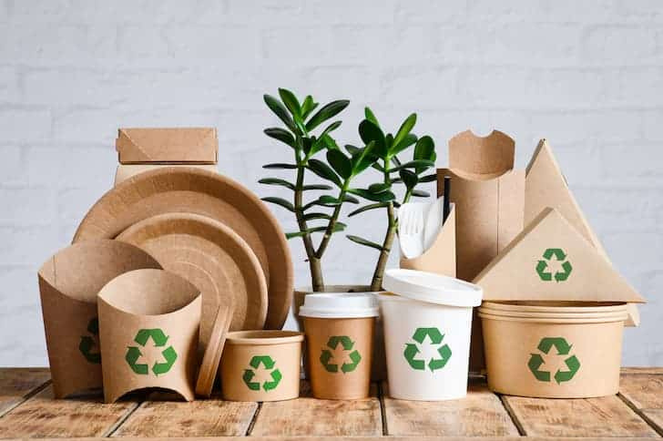
OUR PRODUCTS
TRANSFER PROOF MEALS CONTAINER
LEAK PROOF GRAVY CONTAINER
SIDE CONTAINER
MINI DIPS CONTAINER
DRINKS CUP
COCONUT LEAF STRAW

Slide 12

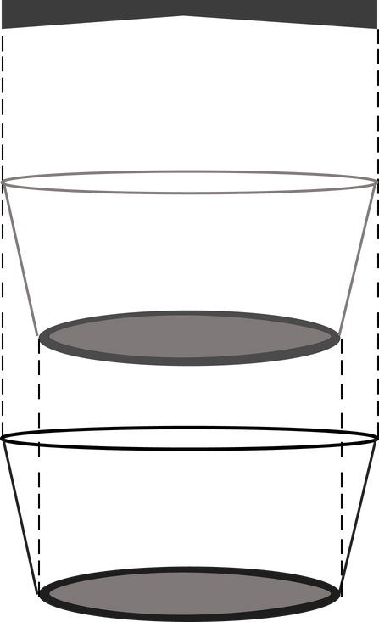
Container Bowl Cost
Sugarcane Raw Material=1rs
Transportation=1rs
Processing=1.30rs
Packaging=0.75rs
Exportation=1.15
GRAVY BOWL LID
Totall=5.20rs
Container Lid Cost
Raw Material=0.75rs
Transportation=1rs
Processing=0.75rs
PLA COATNG
Totall=2.50rs
GRAVY CONTRAINER
PLA Coating=1rs
Overall Total=8.70rs/piece

Slide 13

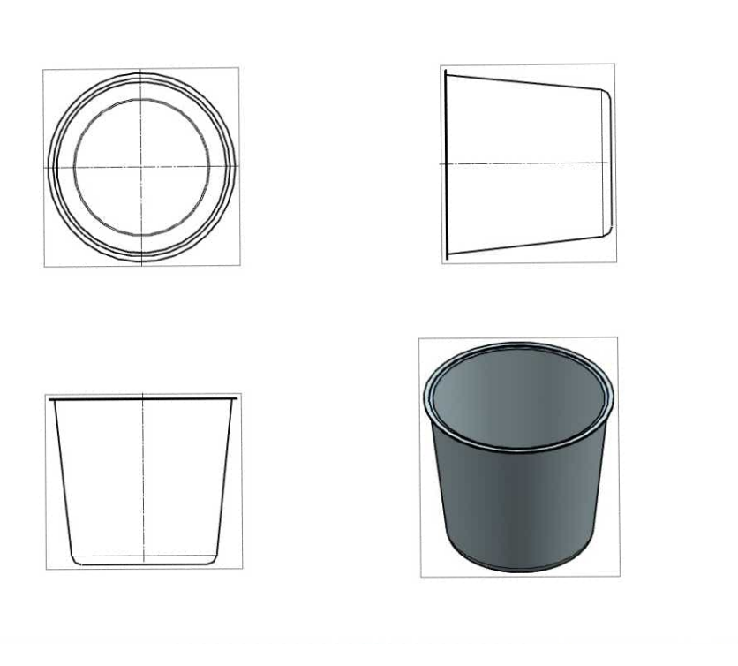
LEAK PROOF GRAVY BOWL

Slide 14

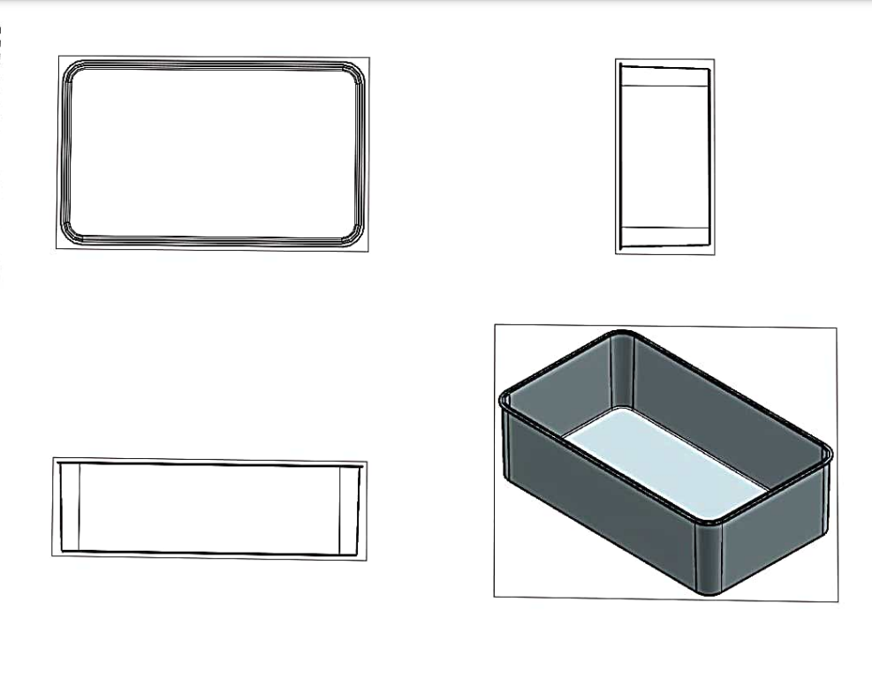
TRANSFER PROOF MEAL BOX

Slide 15
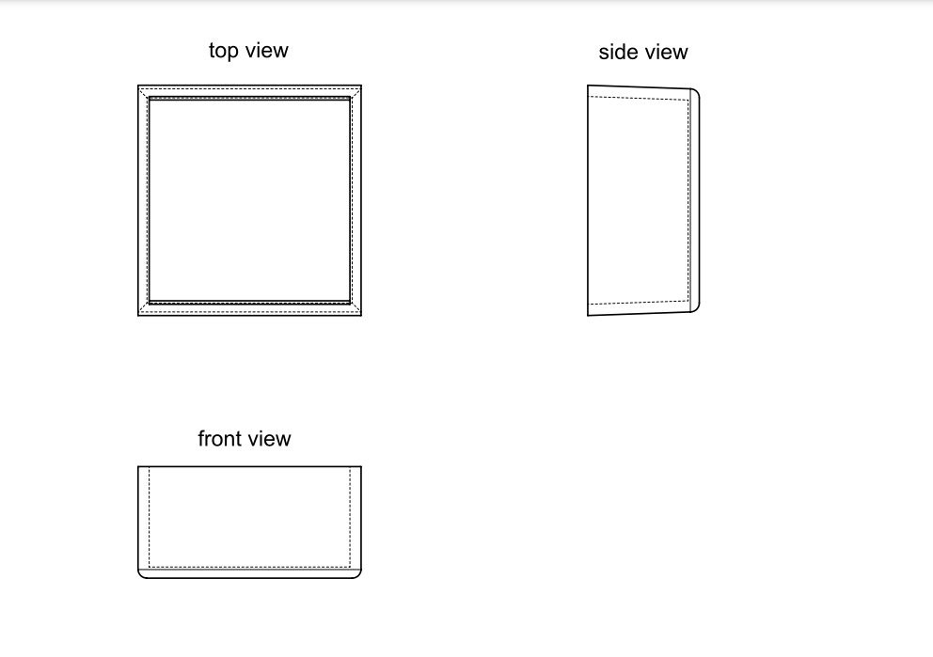
SIDE CONTAINER

Slide 16
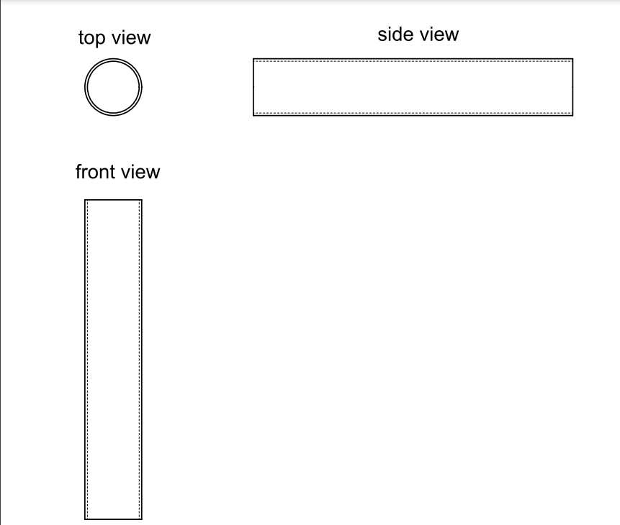
COCONUT LEAF STRAW

Slide 17
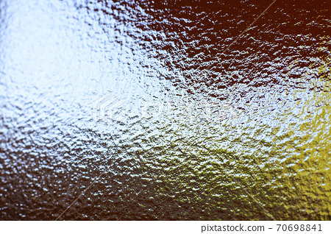
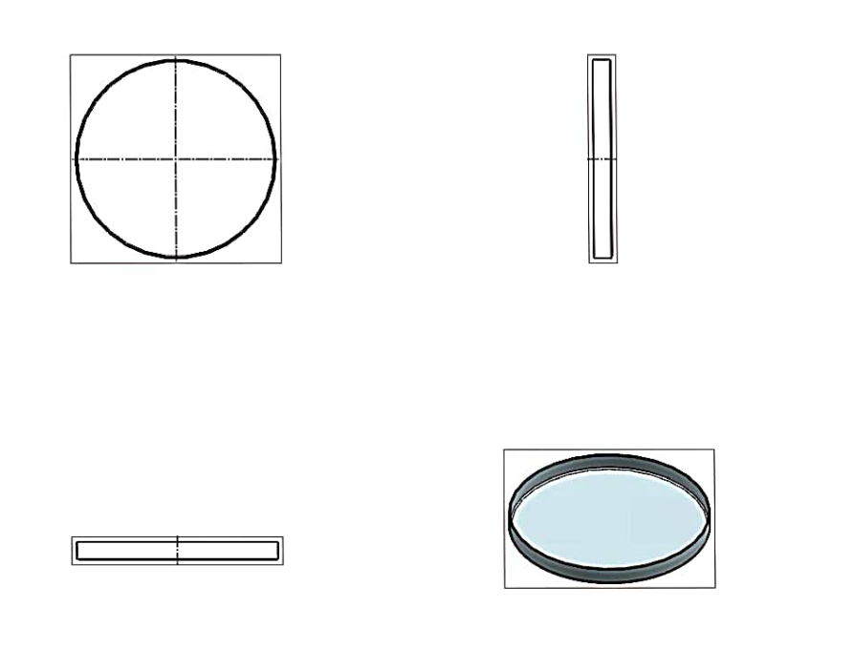
GRAVY BOWL LID

Slide 18
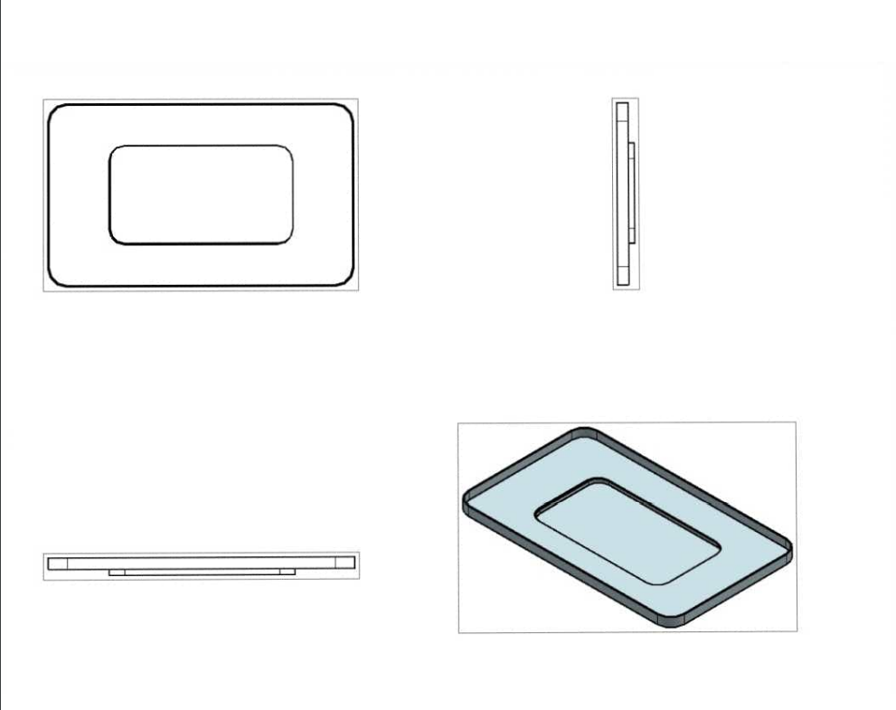
MEAL BOX LID

Slide 19
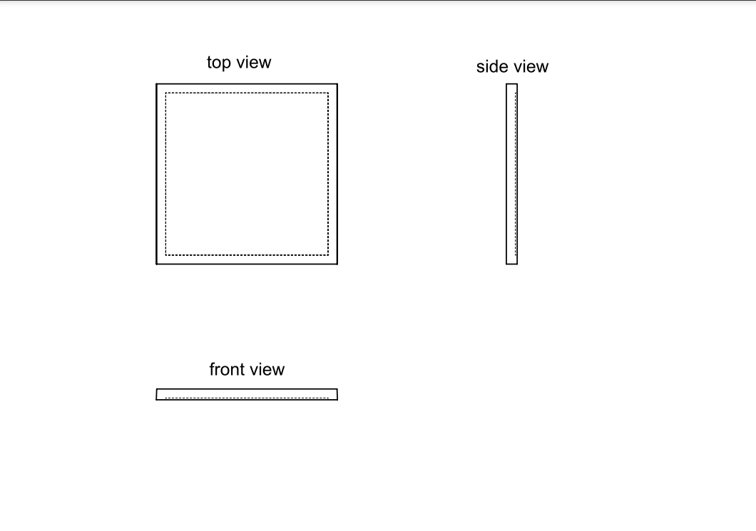
SIDE CONTAINER LID

Slide 20

ADVANTAGES OF THIS PROJECT!
COMBATING PLASTIC POLLUTION
Promoting sustainability
FAUNA FRIENDLY
COST EFFICIENT
HELPS TO PROMOTE A POLLUTION FREE ENVIRONTMENT
REDUCES HEALTH RISK
Contributing to a positive impact
MANUFACTURED FROM ENVIRONTMENT FRIENDLY RAW MATERIALS

Slide 21
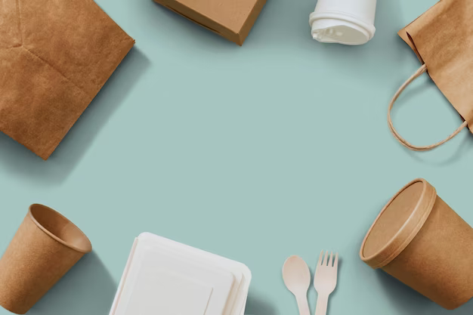
STUFFS THAT MAKE US UNIQUE FROM OTHERS
Renewable Resources
Low Environmental Impact
Support for Agriculture
Consumer Appeal
Unique element of our project is the PLA layer that makes the container more resistant and leak proof

Slide 22

Gained hands-on experience with 3D printing technologies, including operating and maintaining 3D printers.
Learned the fundamentals of CAD modeling and designing components for 3D printing applications.
Contributed to real-time projects, enhancing understanding of prototyping and production processes.
Gained hands-on experience with 3D printing technologies, including operating and maintaining 3D printers.
Learned the fundamentals of CAD modeling and designing components for 3D printing applications.
Contributed to real-time projects, enhancing understanding of prototyping and production processes.
Team members:
1.ALICE JESLYN A: alicejeslyn781@gmail.com
2.ASWIN KUMAR K : aswinkumar2912@gmail.com
3.BINDHYA B : bindhya2004ammu@gmail.com
Thank you

